Slide 1


Title of Presentation:
Please check the PPT notes
By Tony Noble
tony.noble@mcdonaldinstitute.ca
Notes:
This PowerPoint template is intended to provide you with the resources and flexibility needed to create a presentation in your own way while preserving the brand recognition of the McDonald Institute. Please direct any questions or comments to Zac at communications@mcdonaldinstitute.ca
Adjust the size of the title text as needed.

Slide 2


Canada’s Astroparticle Physics Network
Notes:
Optional – promotional slide – can be used as a title or intro slide as you talk about yourself and the McDonald Institute.
Feel free to use this background image for other uses.

Slide 3
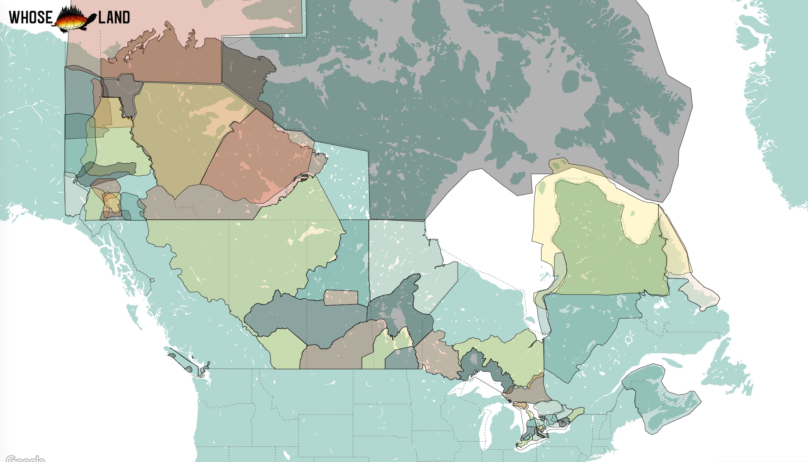
Notes:
https://www.whose.land/en/
The McDonald Institute administrative centre at Queen’s are situated in the traditional territory of the Anishinaabe & Haudenosaunee First Nations. Visit WhosLand.ca to learn about the Indigenous territories where you live all across Canada.
Check your local institution for a suggested basic land acknowledgement.
Land acknowldegments can serve as a useful reminder for people to be engaged in their understanding of the historical and current issues of Indigenous peoples of Canada. Consider including Indigenous perspectives in your presentation or how your presentation might benefit from the inclusion of Indigenous perspectives.

Slide 4



















Notes:
Optional – promotional slide – McDonald Institute partners (individual images)
Feel free to use the image for other uses.
“The McDonald Institute brings together 11 Universities, 3 Research Institutes and 2

Slide 5
Heading
Slide text
You can cycle through these basic slide designs, or choose one to use throughout the presentation.
Notes:
Slide style 1: You can cycle through these slide designs or choose one to use throughout the presentation.

Slide 6
Heading
Slide text
You can cycle through these basic slide designs, or choose one to use throughout the presentation.
Notes:
Slide style 2: You can cycle through these slide designs or choose one to use throughout the presentation.

Slide 7
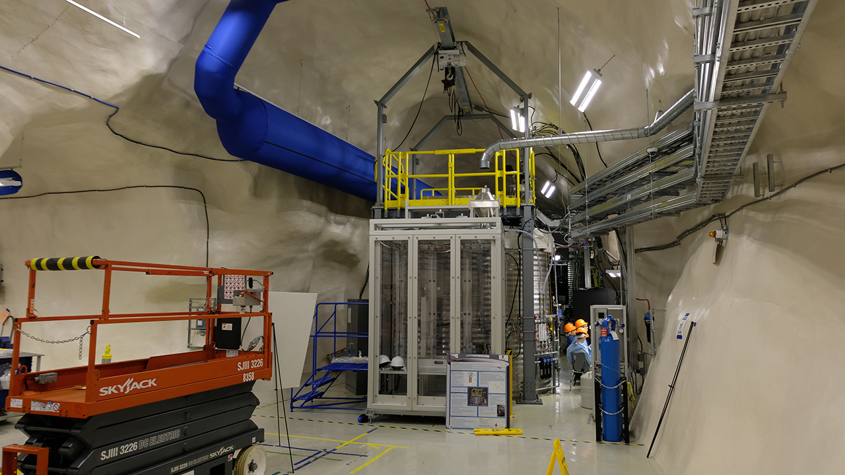

Notes:
Slide style 2: with an image

Slide 8

Notes:
You can also use a blue background as a border for an image.

Slide 9
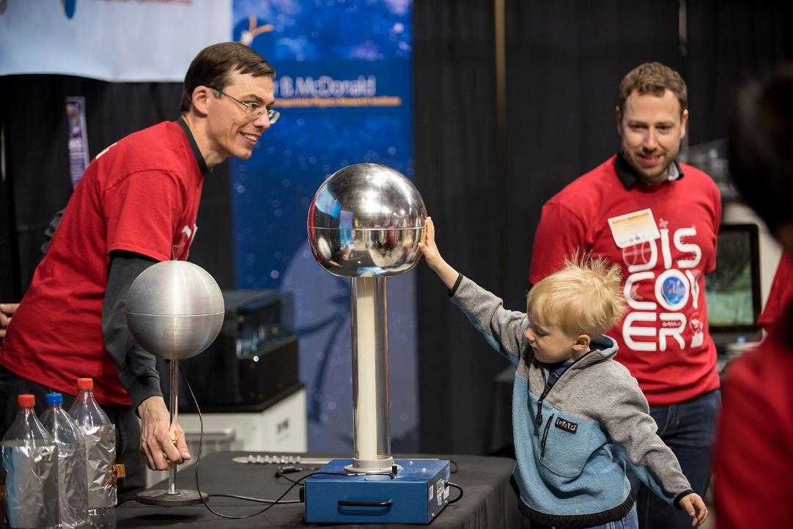
Slide text
You can cycle through these basic slide designs, or choose one to use throughout the presentation.
Notes:
Or as a stylish backdrop for an image

Slide 10
Notes:
Images often look best when displayed full frame.

Slide 11
Notes:
Don’t be afraid to remove all text and use a blank, black slide.
This brings the attention back to you and helps keeps your audience engaged.

Slide 12
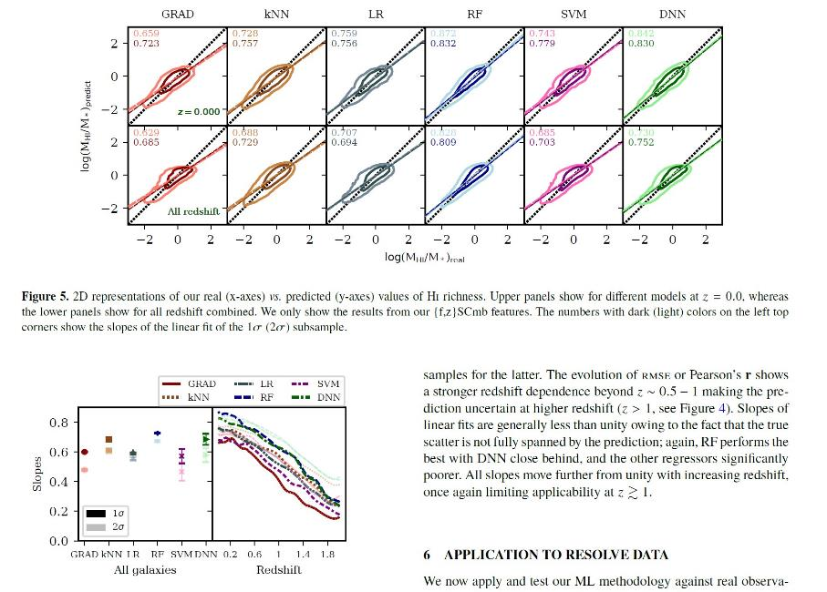
Notes:
You can use the templates with images or plots.
Threre’s too much going on in this slide. Focus on one thing at a time (see next)
McDonald Institute Communications Officer Zac Kenny has a presentation on Data Visualization here: https://queensuca-my.sharepoint.com/:p:/g/personal/physparc_queensu_ca/EdaVlCEEQm1NltZrT3MAYVkBU8FbO0HC4GSvoX2zlLiBhA?e=NLwG9G

Slide 13
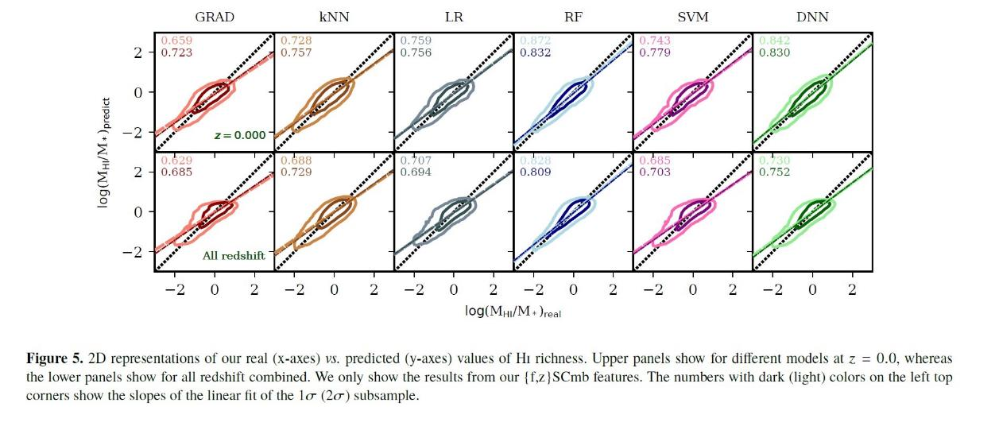
Notes:
Better to focus on one thing at a time.
No need to always use the colour bars in every slide

Slide 14
Notes:
Branded slide templates can sometimes be distracting. Feel free to use the “Blank, No Base” style wherever you have detailed information.

Slide 15
Thank you
Contact me at: tony.noble@mcdonaldinstitute.ca
This research was undertaken thanks in part to funding from the Canada First Research Excellence Fund and the Natural Sciences and Engineering Research Council of Canada through the Arthur B. McDonald Canadian Astroparticle Physics Research Institute.
Notes:
Acknowledging the McDonald Institute and CFREF
When people supported by the McDonald Institute publish research results, or accept honours for research undertaken with support from the McDonald Institute, we instruct them to provide parenthetical, footnoted or endnote acknowledgement following this script:
“This research was undertaken thanks in part to funding from the Canada First Research Excellence Fund and the Natural Sciences and Engineering Research Council of Canada through the Arthur B. McDonald Canadian Astroparticle Physics Research Institute.”
As a rule, we would acknowledge CFREF and NSERC anytime direct research cost supports (direct funding) has been used, and we would not when only indirect support has been used.
The full guidelines document for acknowledging CFREF funding support can be found at: https://www.cfref-apogee.gc.ca/program-programme/communication_guidelines-lignes_directrices-eng.aspx
Guidelines for acknowledging NSERC support can be found at: https://www.nserc-crsng.gc.ca/NSERC-CRSNG/acknowledgement_and_logos-mention_et_logos/index_eng.asp

Slide 16

Join us online at:
McdonaldInstitute.ca
Notes:
Optional – promotional slide
Feel free to use this background image for other uses.

Slide 17






Notes:
Additional resources: Logos.
Please use the full logo in colour where possible.
Other variations including the one-colour logo, the wordmark, the symbol, and the condensed logo are only to be used when space restrictions do not allow for visibility of the full logo.
For guidelines on brand element usage, please see: https://mcdonaldinstitute.ca/wp-content/uploads/Branding/Astroparticle-Physics-Graphic-Toolkit-Guide-2018.pdf

Slide 18








Notes:
Additional resources: Logos. (black or dark background variants).
Please use the full logo in colour where possible.
Other variations including the one-colour logo, the wordmark, the symbol, and the condensed logo are only to be used when space restrictions do not allow for visibility of the full logo.

